Slide 1
Deep Learning for Demand Forecasting in Retail Using Hybrid CNN-RNN and Transformer Models
DL for Supply Chain Optimization in Retail
CSE 676: Deep Learning, Summer 2025
NAME: Raghulchellapandiyan Senthil Kumaran UBID: raghulch
NAME: Dongyoon Shin. UBID: dongyoon
DATE: 7/2/25

Slide 2
PROJECT DESCRIPTION
In this project, we tackle a key challenge in retail: accurately forecasting future demand. Reliable forecasts are essential for optimizing inventory, reducing costs, and meeting customer expectations. Traditional models like ARIMA and Holt-Winters often fail with high-dimensional, noisy retail data. Deep learning offers a powerful alternative by learning complex patterns and temporal dependencies. Our goal is to benchmark various deep learning models under clean and noisy conditions to identify the most robust and accurate approach for real-world retail forecasting.

Slide 3
BACKGROUND
Time Series Forecasting has historically used statistical models which assume stationarity & linearity. They work well in the context of the narrow cases, however when dealing with high-dimensional, multivariate retail data they are less effective. Deep learning structures such as LSTM, GRU, CNN-RNN hybrids, and Transformer models are more flexible, as they can learn raw sequences and non-linear trends. It has previously been demonstrated that Transformers are effective for both language modeling
and multivariate time series forecasting. We extend this result by evaluating several deep learning models on the same setting. We go one step further by adding artificial noise into the dataset, corresponding to data corruption in the real world, and examine how the robustness of model changes.
We compared these results with the results of:
Baselines: Linear Regression and Feedforward Neural Network Models
Deep Learning: LSTM, GRU, transformer and CNN-RNN

Slide 4
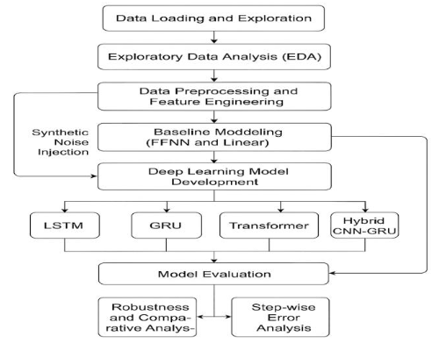
BACKGROUND
What we bring to the table is a single framework that enables the training and evaluation of all models on both clean and noisy datasets and interpretability analysis with the LLaMA-inspired. Such a detailed comparison is rare in retail forecasting literature, particularly in the nois case. In recent literature, deep learning has consistently outperformed traditional methods in multivariate time series forecasting.
For example, the survey by Eglīte & Birzniece (2022) highlights how models like LSTM, GRU, and Transformer improve retail inventory efficiency [https://www.researchgate.net/publication/360626956]. Robust models such as CNN-GRU:
[https://www.researchgate.net/publication/364062468].
Transformer-based architectures [https://arxiv.org/pdf/2206.12106.pdf] have shown higher accuracy and better generalization, especially with synthetic noise injection techniques.

Slide 5
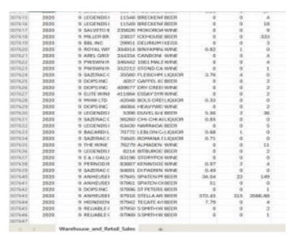
DATASET
The Warehouse and Retail Sales dataset, published by Immersible, was used in this https://catalog.data.gov/dataset/warehouse-and-retail-sales.
dataset consisting of more than 307 K livestream records a month through products and vendors. The features are YEAR, MONTH, SUPPLIER, ITEM TYPE, RETAIL SALES, RETAIL TRANSFERS and WAREHOUSE SALES. The volume and multivariate nature of the data makes this a great candidate to train deep models for learning demand trends over time.

Slide 6
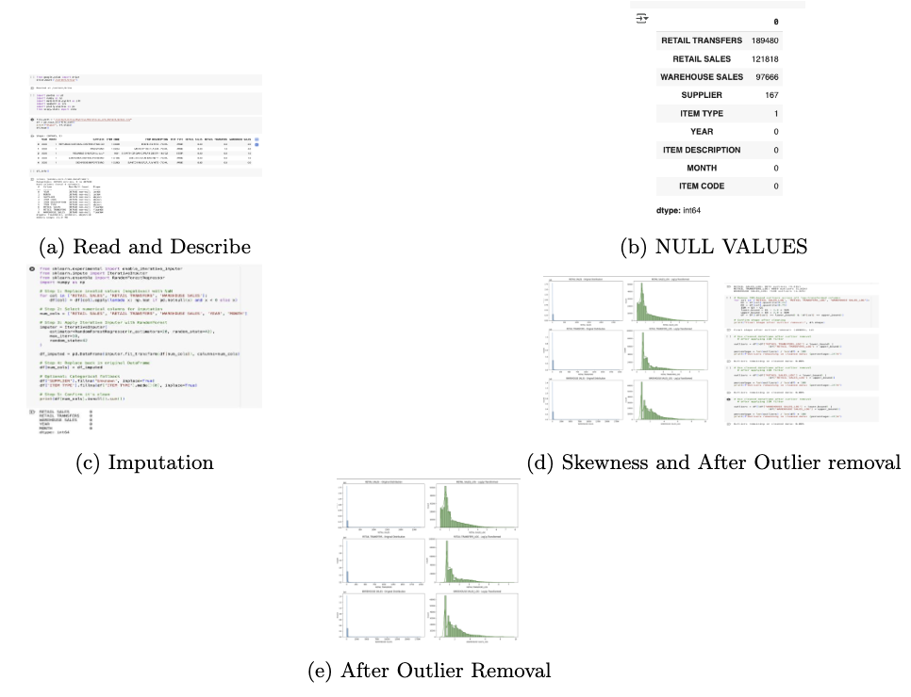
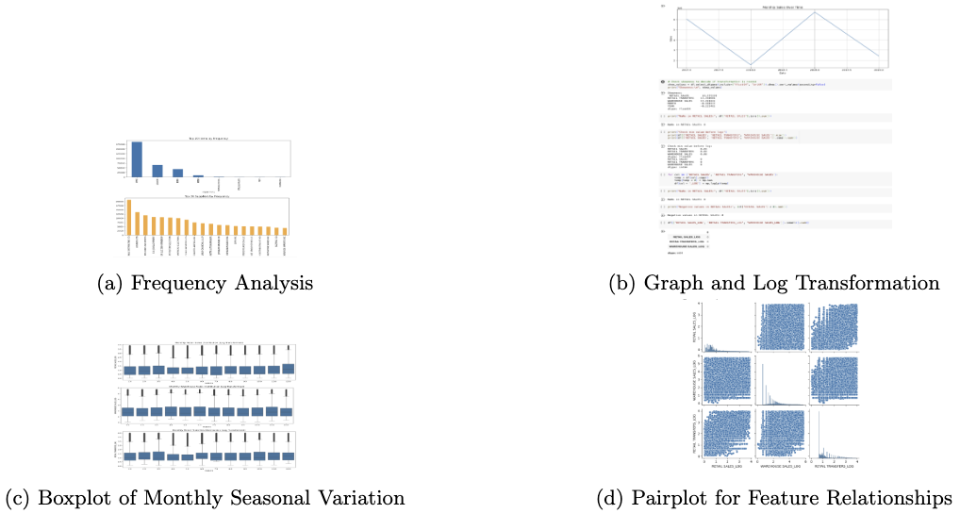
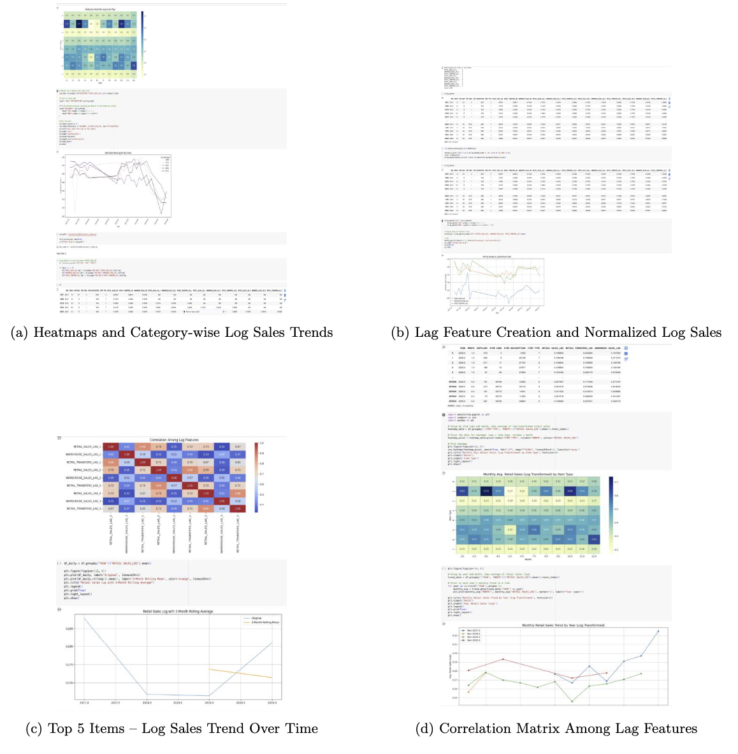
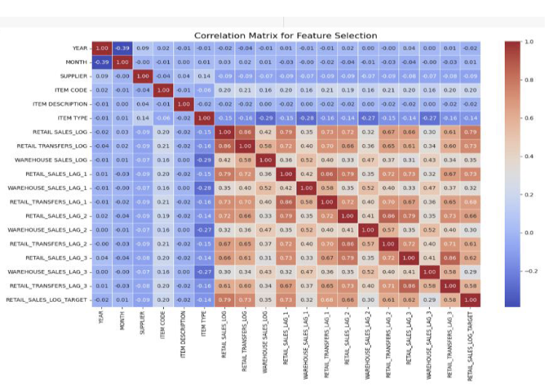
DATASET
Data Preprocessing In addition to the manipulation to imitate missing values and respect sensitivity constraints, the data was also preprocessed.
We imputed missing values with IterativeImputer using a RandomForestRegressor.
To score copy number, we adjusted for skewness with log1p adjustments.
IQR was used to delete the 2.5/97.5 percentile of extremal data.
1-3 month offsets lags were generated as the lag features.
Features were normalized using MinMaxScaler.

Slide 7
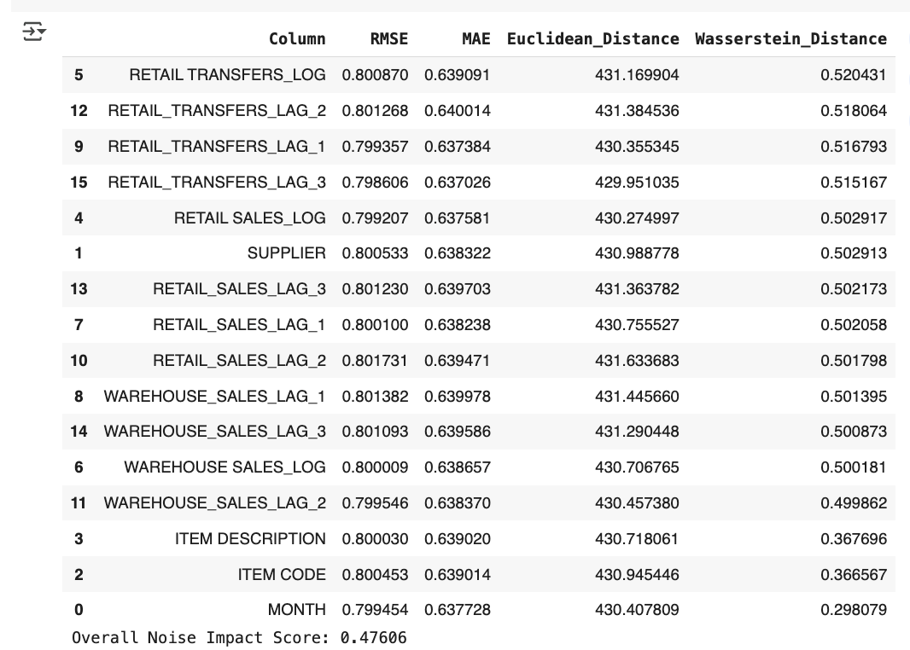
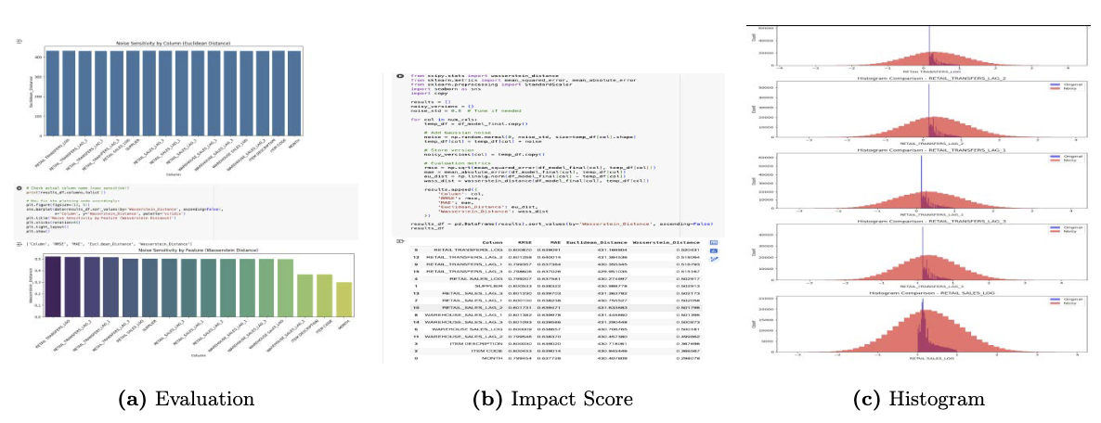
METHODS
Our task in this challenge is to predict the next 6 months of retail sales given the last 12 months of data. This formulation turns the problem into a supervised learning problem. We made data in sliding windows (of shape (batch, 12, num_features) with output shape (batch, 6, num_targets)). We used Gaussian noise (σ = 0.8) on a subset of input features to evaluate robustness. Sensitivity analysis and comparison of the correlation matrixes were used to evaluate the noise injection rigorously before and after noise.

Slide 8
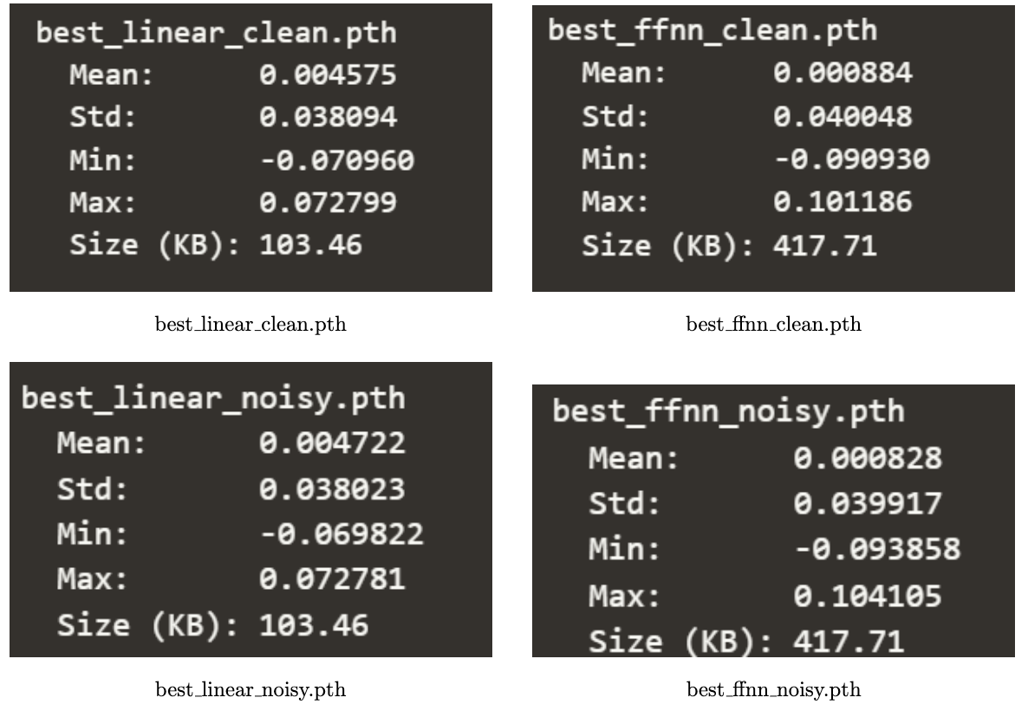
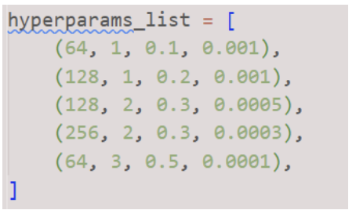
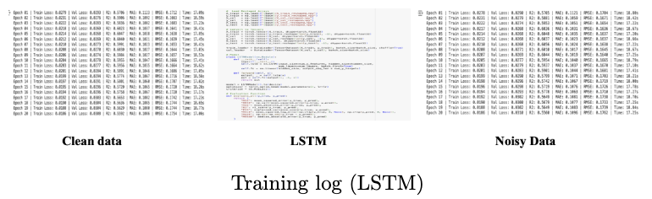
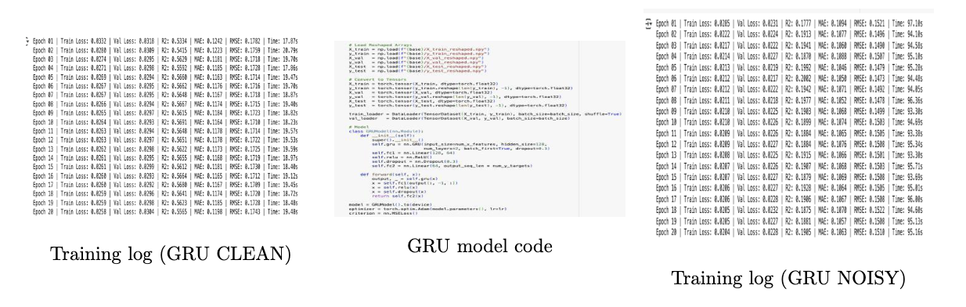
METHODS
We trained two baseline models: Linear Regression & Feedforward Neural Network (FNN). The FNN model has the ReLU activations, dropout layers, and trained with Adam optimizer. Neither of these models are encoded with sequence models. For deep models:
LSTM and GRU were applied to encoder-decoder architectures.
Transformer employed multi-head attention with positional encoding.
CNN-RNN integrated Conv1D layers with GRUs for learning temporal patterns.
After obtaining the baseline results, 5 sets of hyperparameters have been used to tune the model and find the best one.

Slide 9
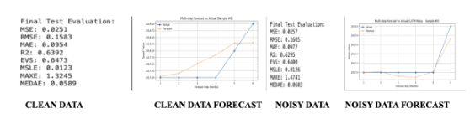
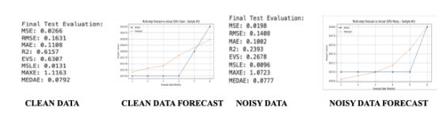
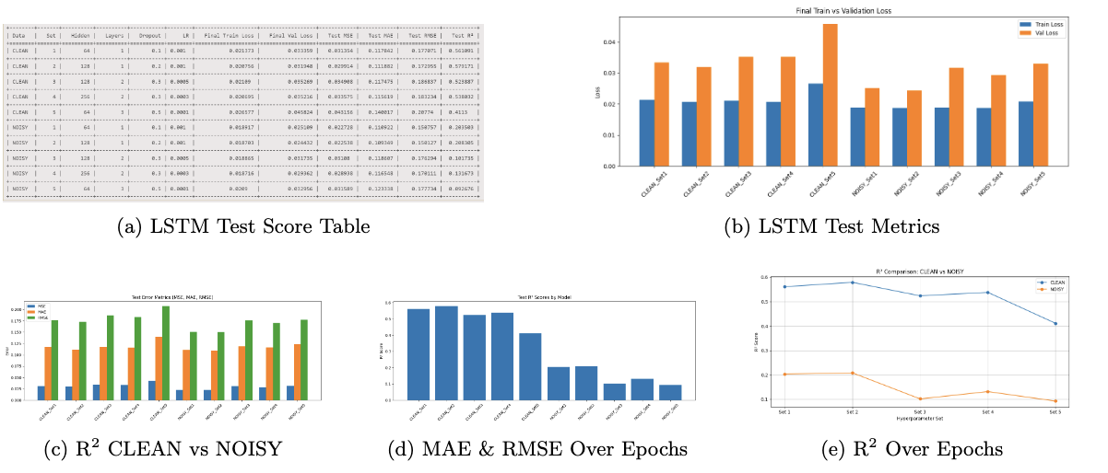
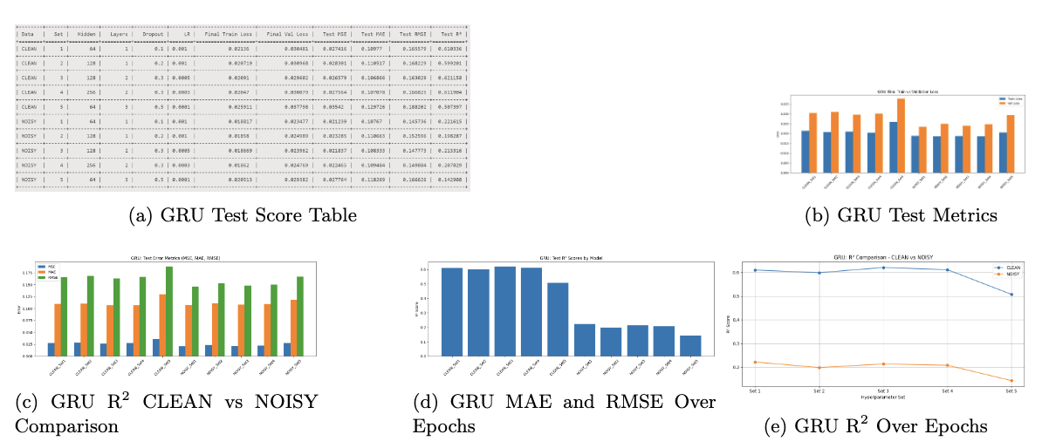
RESULTS – LSTM & GRU
Baseline Performance (Clean Data):
LSTM: R² = 0.6392, RMSE = 0.1583, MAE = 0.0954
GRU : R² = 0.6157, RMSE = 0.1631, MAE = 0.1108
Baseline Performance (Noisy Data):
LSTM: R² = 0.6295, RMSE = 0.0585, MAE = 0.0972
GRU: R² = 0.2393, RMSE = 0.1408, MAE = 0.1002
After Hyperparameter Tuning – Best Set (Clean Data):
LSTM (Set 2): R² = 0.5791, RMSE = 0.172955, MAE = 0.111882
GRU (Set 1): R² = 0.6103, RMSE = 0.165579, MAE = 0.10977
After Hyperparameter Tuning – Best Set (Noisy Data):
LSTM (Set 2): R² = 0.2083, RMSE = 0.150127, MAE = 0.1093
GRU (Set 1): R² = 0.2216, RMSE = 0.145736, MAE = 0.1076
Clearly, GRU (Set 1), worked well with both clean and especially noisy data which is more robust.

Slide 10
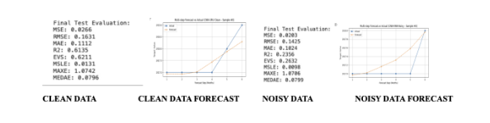
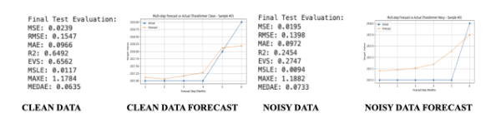
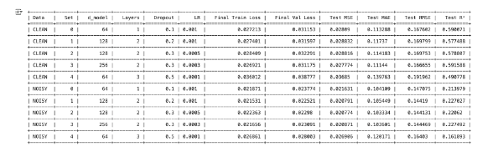
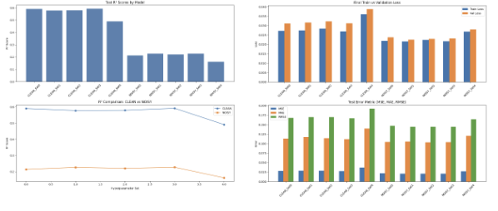
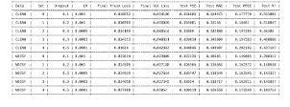
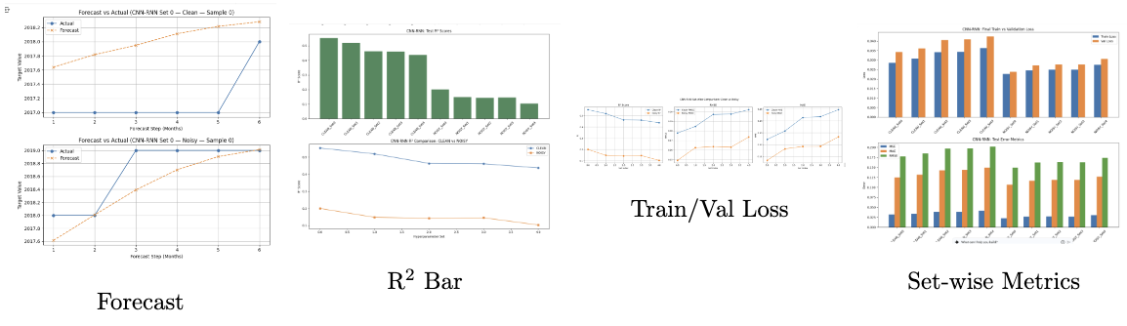
RESULTS – TRANSFORMER & CNN-RNN
Baseline Performance (Clean Data):
Transformer: R² = 0.6492, RMSE = 0.1547, MAE = 0.0966
CNN-RNN : R² = 0.6135, RMSE = 0.1631, MAE = 0.1112
Baseline Performance (Noisy Data):
Transformer: R² = 0.2454, RMSE = 0.1398, MAE = 0.0972
CNN-RNN: R² = 0.2356, RMSE = 0.1425, MAE = 0.1024
After Hyperparameter Tuning – Best Set (Clean Data):
Transformer (Set 3): R² = 0.59155, RMSE = 0.166655, MAE = 0.11144
CNN-RNN (Set 0): R² = 0.553002, RMSE = 0.177778, MAE = 0.124473
After Hyperparameter Tuning – Best Set (Noisy Data):
Transformer (Set 3): R² = 0.227492, RMSE = 0.144469, MAE = 0.103601
CNN-RNN (Set 0): R² = 0.148638, RMSE = 0.162372, MAE = 0.116564
Clearly, Transformer (Set 3), worked well with both clean and especially noisy data which is more robust.
Transformer
CNN-RNN

Slide 11
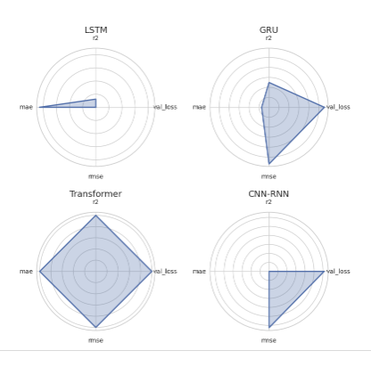
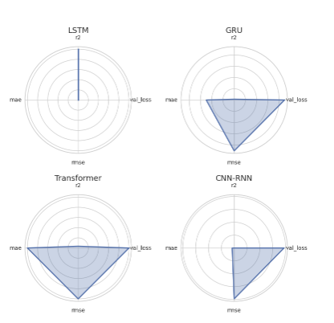
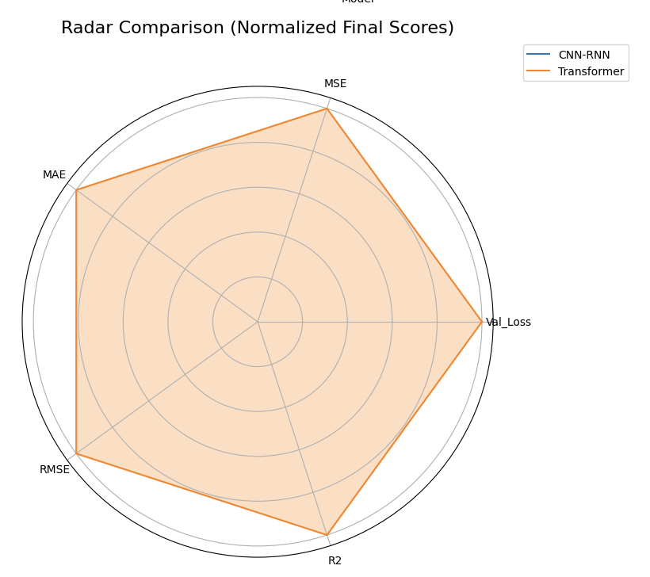
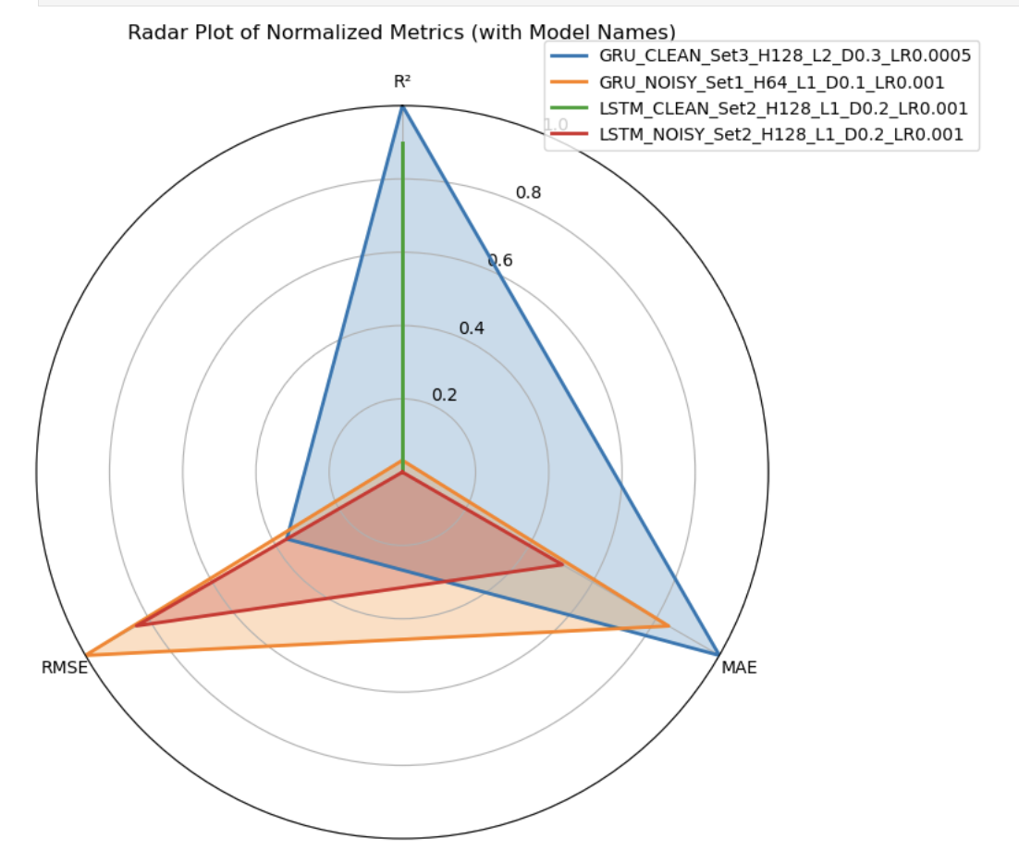
RESULTS – BEST MODEL
BASELINE CLEAN
Baseline Comparison:
Transformer outperformed all other models on clean data with R² = 0.6492, RMSE = 0.1547, MAE 0.0966. This indicates its strong ability to learn long-range temporal dependencies even without tuning.
After Hyperparameter Tuning:
GRU Set 1 provided the best trade-off between clean and noisy performance.
On clean data: R² = 0.6103, RMSE = 0.1656, MAE = 0.1098 On noisy data: R² = 0.2216, RMSE = 0.1457, MAE = 0.1076
Although not the absolute best in accuracy, GRU was the most robust model across both environments.
Best Baseline (Clean): Transformer Best Overall After Tuning: GRU Set 1
The GRU’s gating mechanism likely contributed to better noise resilience. Transformer had high variance under noise despite strong clean-data performance.
BASELINE NOISE

Slide 12
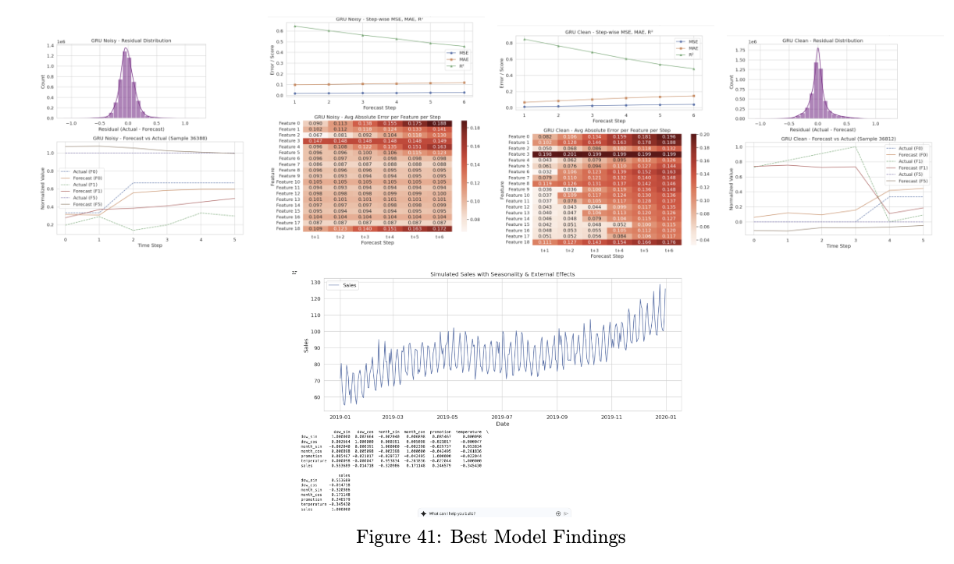
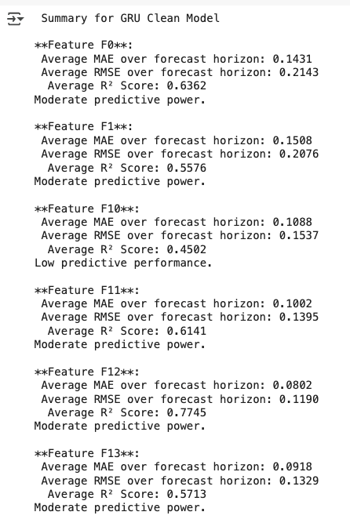
KEY OBSERVATION : BEST MODEL – GRU(SET 1)
GRU Set 1 showed the best performance overall, especially under noisy conditions
Transformer achieved the highest accuracy on clean data but degraded under noise
Forecast accuracy declined with horizon steps; Feature 3 was hardest to model
GRU maintained smooth forecasts despite noise, showing strong generalization
Residuals followed a centered Gaussian, indicating low bias; clean data was more precise
LLaMA-style analysis revealed which features were predictable and improved interpretability

Slide 13
CONTRIBUTION TABLE AND GIT-WHO

Slide 14
REFERENCES
• Kaggle NAB Dataset: https://www.kaggle.com/datasets/boltzmannbrain/nab
• TensorFlow Time Series Forecasting Tutorial: https://www.tensorflow.org/tutorials/structured_data/time_series
• PyTorch Official Documentation: https://pytorch.org/docs/stable/index.html
• Illustrated Transformer Blog: https://jalammar.github.io/illustrated-transformer/
• Attention is All You Need (Vaswani et al., 2017): https://arxiv.org/abs/1706.03762
• MinMaxScaler – Scikit-learn: https://scikit-learn.org/stable/modules/generated/sklearn.
Seaborn Visualization: https://seaborn.pydata.org/

Slide 15
THANK
YOU!

